Slide 1
Smart Mattress System
Domain : Fuzzy Logic System
By Akshay Uppal

Slide 2
Motivation
Characteristics of System
System Details
Working of System/ Demo
Benefits
Future Scope

Slide 3
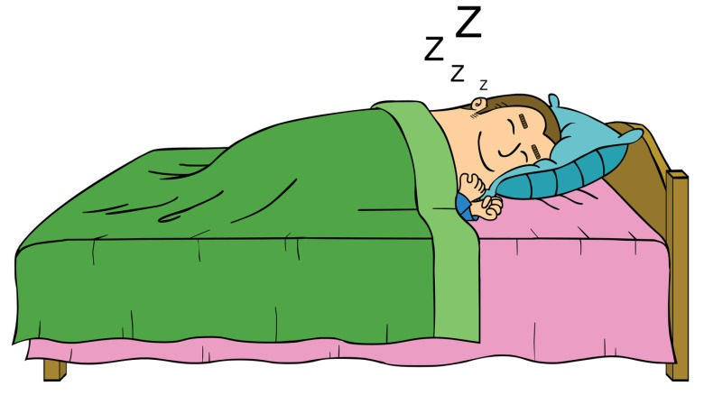
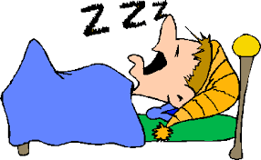
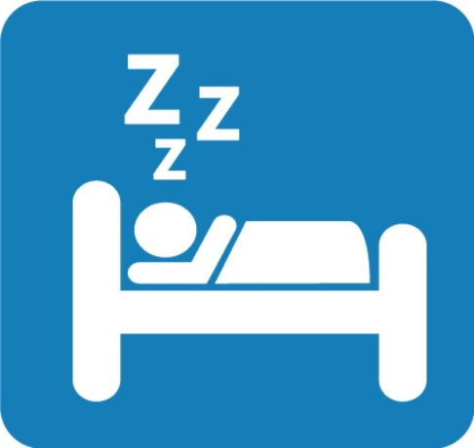
Motivation

Slide 4
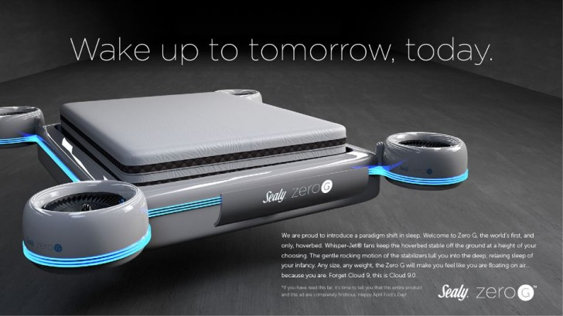
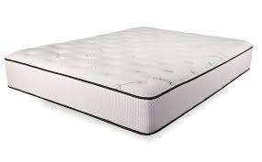
Traditional Mattress
Mattress of Future

Slide 5
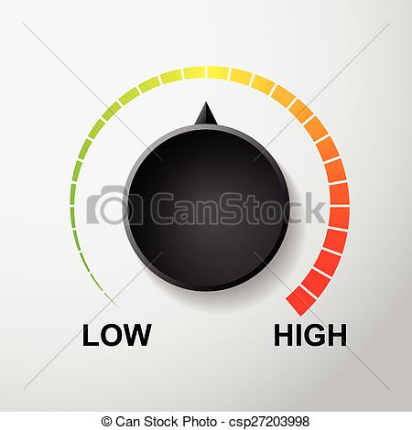
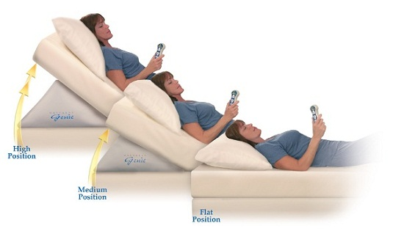
Characteristics of Smart Mattress

Slide 6
Temperature Control
Calibrates temperature based on outside temperature
Pressure sensitive temperature control
Energy Efficient

Slide 7



Slide 8
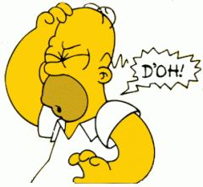

Slide 9
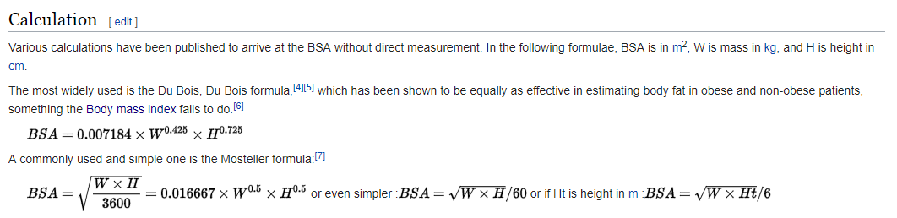
Body Surface Area Calculation
Du Bois Formula

Slide 10
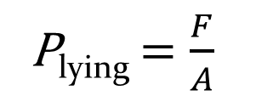
Pressure of
body lying down
P_{lying} $=\frac{F}{A}$
Weight of the body
Body Surface Area

Slide 11
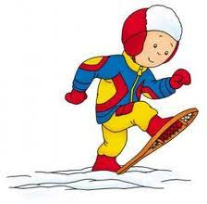


Ground pressure variations
~3.5 kPa
~55kPa
~300-500Pa

Slide 12
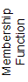
Pressure Fuzzy Set
Pressure_{Global} : 0 -5000 Pa
PiFuzzy Set
-150
P_{calculated}
+150

Slide 13
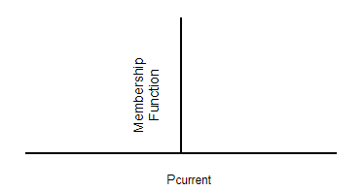
Pressure Fuzzy Set
-150
P_{calculated}
+150
Fuzzy Match
Singleton set

Slide 14
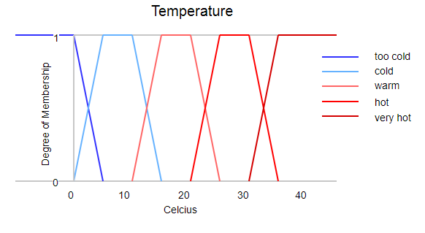
Fuzzy sets

Slide 15
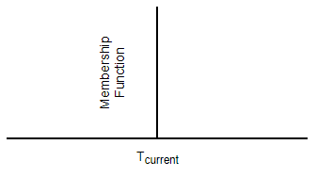
Fuzzy sets
Trapezoid Fuzzy Set
Fuzzy Match
Singleton Fuzzy Set

Slide 16
More Cool
More Heat

Slide 17
More Cool
More Heat
Heat Change
Cold Change

Slide 18
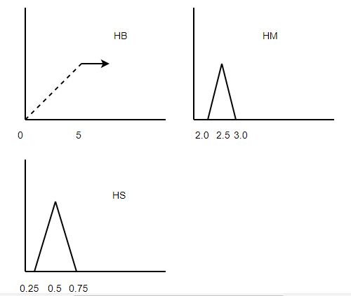
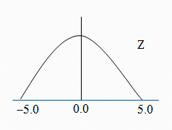
Fuzzy sets
Temperature change Fuzzy Sets
Heat Change

Slide 19
Heat and Cold Change Rule
Fuzzy Match | Change Heat | Change cool
Too cold | HB | Zero
Cold + Too cold | HM | Z
Cold | HM | Z
Warm + Cold | HS | Z
Warm | Z | Z
Warm + Hot | Z | CS
Hot | Z | CM
Hot + too Hot | Z | CM
Too Hot | Z | CB

Slide 20
Pressure matched
with calculated pressure
Current Temperature
Readings received
Change Temperature

Slide 21
Intelligent Posture Control
Measure sleepiness index to adjust the posture for the mattress
Calibrates postures based on sleepiness of the person
Angle varies from 120 to 180
Measures sleep based on PERCLOS

Slide 22
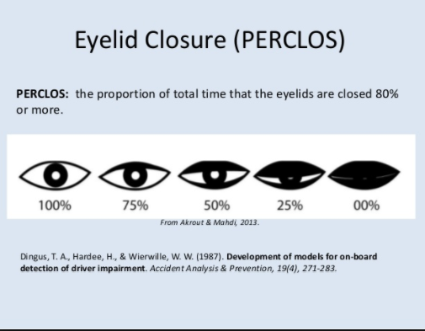
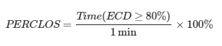
PERCLOS
(Percentage of eye closure)

Slide 23




Driver drowsiness detection
The Driver Monitoring System, also known as Driver Attention Monitor, is a vehicle safety system first introduced by Toyota in 2006 for its and Lexus and latest models.
Other technology being used
Driver eye/face monitoring
Physiological measurement
Driver eye/face monitoring
Physiological measurement
Applications
Rest recommendation system
Active Driving Assistant
Driver Alert
Driver Condition Monitor and Driver Fatigue Alert

Slide 24
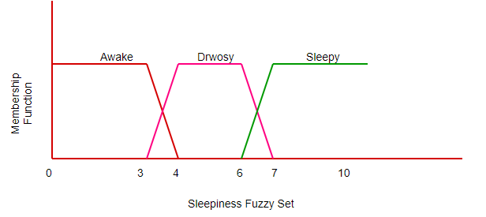
Sleepiness Index

Slide 25
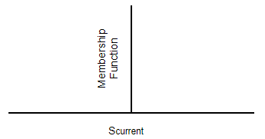
Sleepiness Index

Slide 26
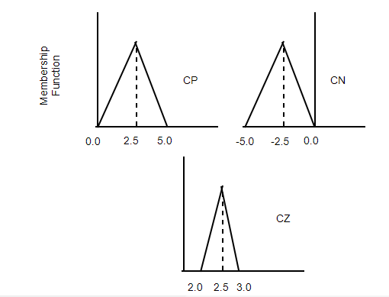
Angle Change Fuzzy Sets

Slide 27
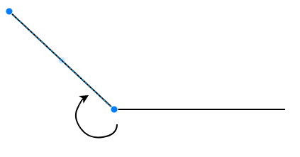
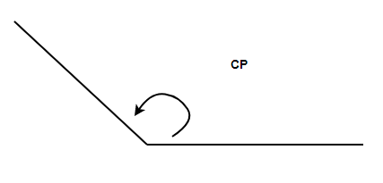
Angle Change Rule
Sleepiness value | Current Angle | Change Angle
Awake | > 120 | CN
Drowsy | <=180 | CZ
Sleepy | <=180 | CP
CN
CP

Slide 28
Check Current Angle
Current Sleepiness
Readings received
Change Angle of mattress

Slide 29
Sensor Reading
Black box
Output
Current temperature
Users body weight and height
Smart Mattress System
Temperature and
Angle Change
Sleepiness Value
Current pressure

Slide 30
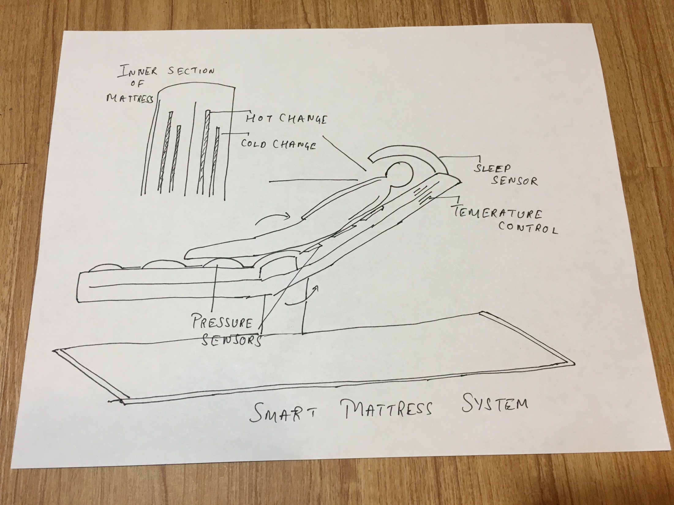
Sketch

Slide 31
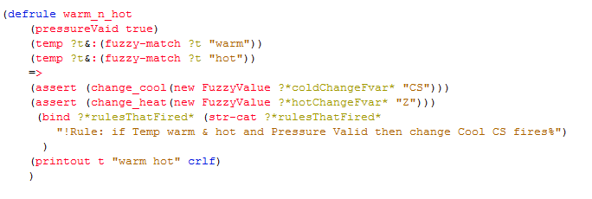
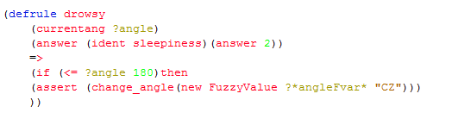
A typical rule

Slide 32
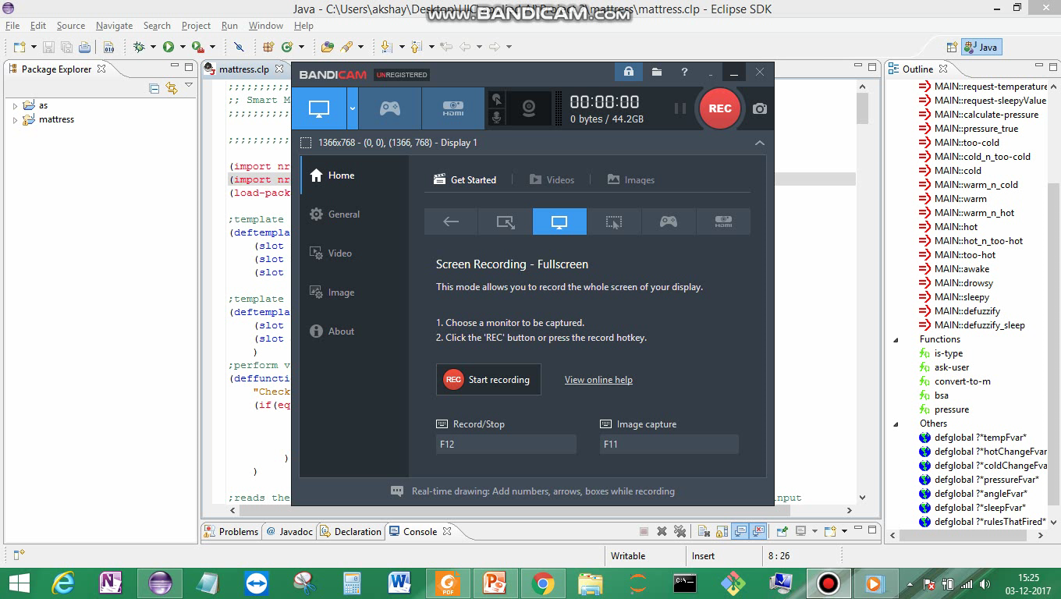
Demo

Slide 33
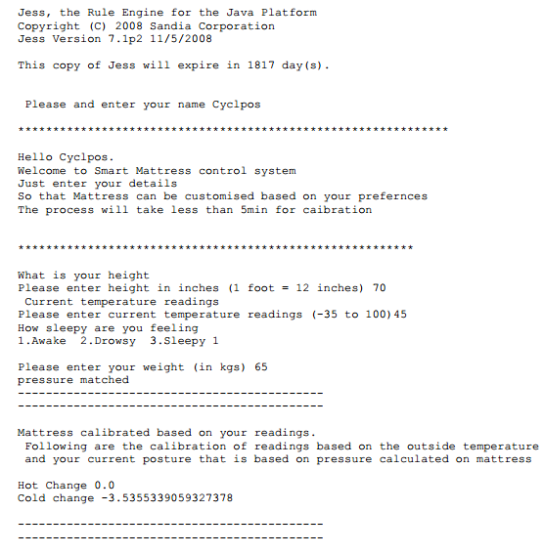
Sample Run- I

Slide 34
Value Proposition and Benefits
Saves energy during temperature control
Adjusts the posture based on user sleepiness value
More personalised towards the user
Humans spend 1/3 of their time sleeping

Slide 35
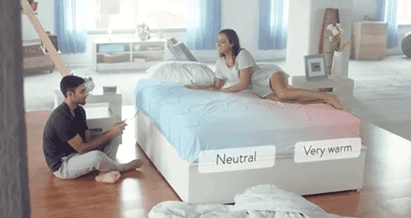
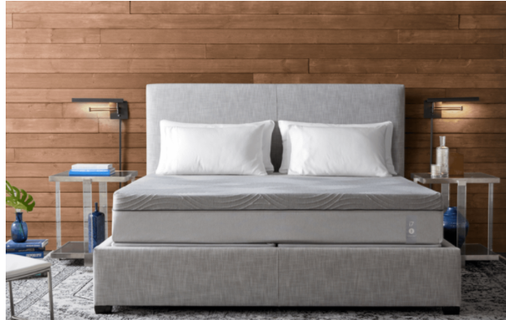
Existing Market
Remote control based
Temperature control
Doesn’t used pressure sensitive control
Lacks detection of drowsiness
Eight Sleep
Sleep Number 360

Slide 36
Future Scope
In future bed will take sleep index value based on EEG- ECD model (87.5 – 70%) or by measuring brain activity.
Make the changes in the control more smoother
Tracks the sleep pattern of the user and give him feebback

Slide 37
Citations
https://www.researchgate.net/publication/260232896_Temperature_Control_using_Fuzzy_Logic
https://www.seeingmachines.com/technology/
http://halls.md/formula-body-surface-area-bsa/
https://en.wikipedia.org/wiki/Body_surface_area#Calculation
https://en.wikipedia.org/wiki/Ground_pressure
Sleep : https://en.wikipedia.org/wiki/Multiple_Sleep_Latency_Test
Sleepiness scale : http://healthysleep.med.harvard.edu/narcolepsy/diagnosing-narcolepsy/epworth-sleepiness-scale
http://www. https://www.ncbi.nlm.nih.gov/pmc/articles/PMC4208235/

Slide 38
Questions?

Slide 39
Thank you

Slide 40
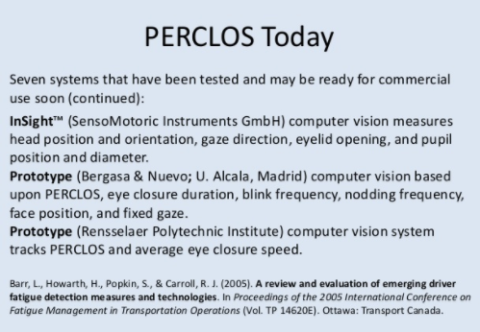

Slide 41
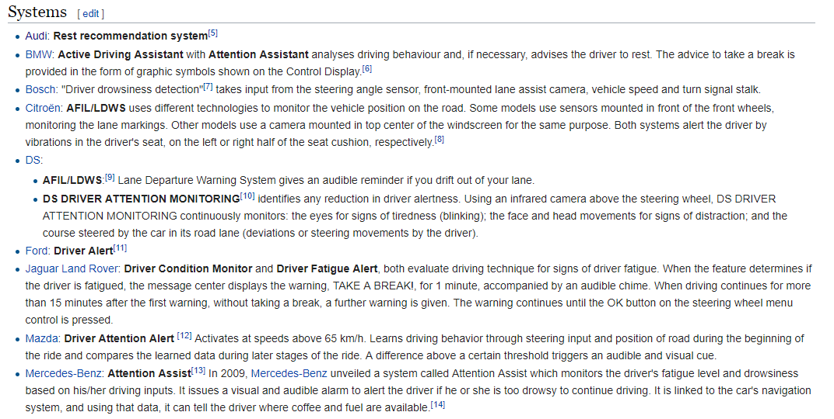
Driver drowsiness detection

